Slide 2
Objectives
Describe the creation of nonrectangular Windows Forms
Explain the TabControl and TrackBar controls
Describe the NotifyIcon component
Describe the various types of ToolStripItems
Describe merging of ToolStrips
Describe the ToolStripContainer class
Explain merging of DataSets

Slide 3
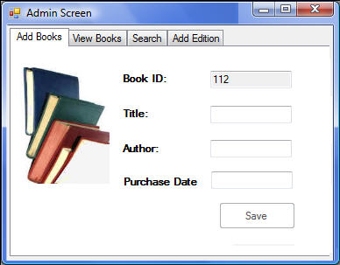
Nonrectangular Forms 1-4
Normal user interface of Windows Forms applications
Nonrectangular Windows Forms applications

Slide 4
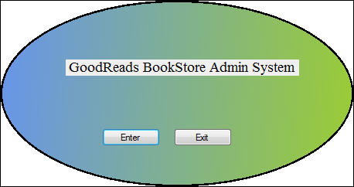
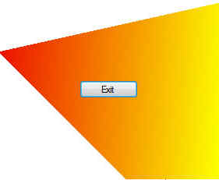

Slide 5
Nonrectangular Forms 2-4
Snippet
Steps to create a nonrectangular form:
Create a C# based Windows Forms application and rename the form to frmEllipse
Set FormBorderStyle property of the form to None
Generate an event handler for frmEllipse_Load and type the following code in the Load event handler
private void frmEllipse_Load(object sender, EventArgs e)
{
this.BackColor = Color.Coral;
System.Drawing.Drawing2D.GraphicsPath path = new
System.Drawing.Drawing2D.GraphicsPath();
path.AddEllipse(0, 0, this.Width, this.Height);
this.Region = new Region(path);
}
GraphicsPath class defined in the System.Drawing.Drawing2D namespace
GraphicsPath class enables you to represent a series of connected lines and curves

Slide 6
Is a container control used to group controls on a form into tabs
Enables you to create tabbed pages or views
Can contain one or more TabPage controls, each representing a tabbed page
A user can change the current TabPage by clicking one of the tabs in the control
A TabPage control:
Is a special type of container control hosted only inside a TabControl
Cannot exist standalone on a form
Can generate scroll bars as needed if its AutoScroll property is set to True

Slide 7
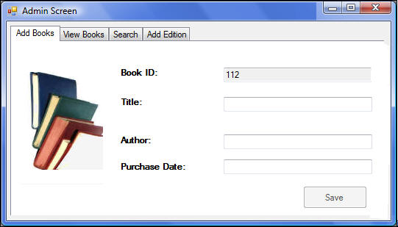
The TabControl Control 1-8
TabPage controls
TabControl
TabPage content

Slide 8
The TabControl Control 2-8
Property | Description
Appearance | Specifies or retrieves the visual style of the TabControl Can have one of three values: Normal, Buttons, or FlatButtons
Alignment | Specifies or retrieves the alignment of the tabs such as Top, Bottom, Left, or Right
Multiline | Specifies or retrieves whether more than one row of tabs is allowed on the TabControl When set to True, multiple rows of tabs are supported
Method | Description
DeselectTab | Specifies or retrieves the tab that is following the given tab as the current tab An index or name of the tab is given as the argument
SelectTab | Specifies or retrieves the tab with the given index or name as the current tab
Event | Description
Deselected | Raises when a tab is deselected
Selected | Raises when a tab is selected
SelectedIndexChanged | Raises when the SelectedIndex property has changed

Slide 9
The TabControl Control 4-8
Commonly used properties of TabPage:
Property | Description
AutoScroll | Specifies whether scroll bars will be displayed or not when controls are hosted outside the visible bounds When set to True, scroll bars are displayed and when set to False, they are not displayed
BorderStyle | Specifies or retrieves the visual appearance of the TabPage border Can be set to None indicating no border; FixedSingle, indicating a singleline border; or Fixed3D, indicating a border with a three-dimensional appearance
Text | Specifies or retrieves the text displayed on the tab in the TabControl for the TabPage

Slide 10
TrackBar Control 1-3
TrackBar example
Provides a slider-like interface that allows you to set a value by scrolling through the slider using either mouse or keyboard
Property | Description
LargeChange | Specifies or retrieves the number of positions by which the slider moves in response to mouse clicks or the Page Up and Page Down keys
Maximum | Specifies or retrieves the maximum value for the TrackBar
Minimum | Specifies or retrieves the minimum value for the TrackBar
SmallChange | Specifies or retrieves the number of positions by which the slider moves in response to arrow keys
TickFrequency | Specifies or retrieves the number of positions between tick marks on the TrackBar
TickStyle | Indicates where ticks appear on the TrackBar. The possible options are None, TopLeft, BottomRight, and Both
Value | Specifies or retrieves the value returned by the TrackBar

Slide 11
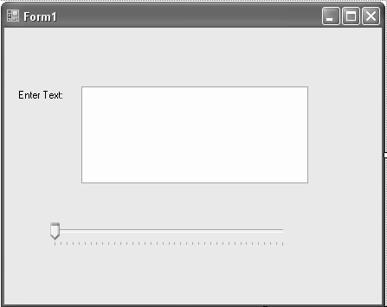

Slide 12
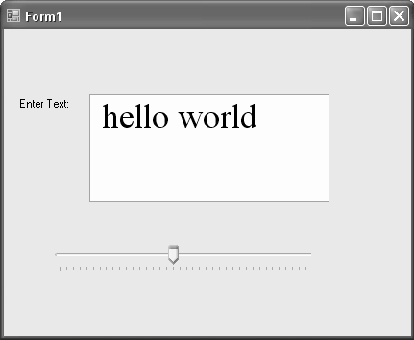
TrackBar Control 3-3
Add the following code to the Scroll event handler
Snippet
private void tkbSize_Scroll(object sender, EventArgs e)
{
float value = tkbSize.Value;
txtText.Font = new Font("Times New Roman", value);
}
Output

Slide 13
The NotifyIcon Component 1-3
Provides a mechanism to notify users when processes are running in the background
Balloon tips, icons, and a ContextMenuStrip can be used with the NotifyIcon to provide notifications

Slide 14
The NotifyIcon Component 2-3
To add icons to your application project:
Create a new instance of the System.Drawing.Icon class or
Add existing icon files by choosing Add Existing Item from the Project menu
After properties are set, you can display the balloon tip by calling ShowBalloonTip()
Assume that you created a button, btnOK, in the application
Clicking the button should result in the notification being shown

Slide 15

The NotifyIcon Component 3-3
Add the following code to the Click event handler for the button
The NotifyIcon component is set to visible and the ShowBalloonTip is passed a value of 5 to indicate five seconds as the duration for which the tip will be seen
If you click the button during program execution, the notification will be shown
Snippet
private void btnOK_Click(object sender, EventArgs e)
{
nicInformation.Visible = true;
nicInformation.BalloonTipText = “The application is running";
nicInformation.ShowBalloonTip(5);
}
Output

Slide 16
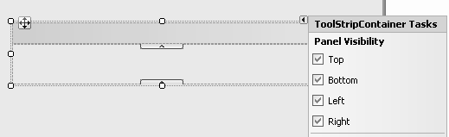
The ToolStripContainer class 1-2
Used to contain tool strips
Supports rafting, the process by which users can drag and drop a tool strip from one edge of the container to another
Contains five panels: four ToolStripPanels (one on each edge of the form) and one ContentPanel respectively

Slide 17
The ToolStripContainer class 2-2
You can control the availability of the tool strip panels using one of two ways:
By setting the following properties: TopToolStripPanelVisible, BottomToolStripPanelVisible, LeftToolStripPanelVisible, and RightToolStripPanelVisible
By checking the checkboxes for the ToolStripPanels
When you set the Dock property of the ToolStripContainer to Fill, it causes the ToolStripContainer to fill the entire form
The tool strip panels would be available on all four sides

Slide 18
Merging DataSets 1-3
Merge() method of DataSet class merges a given DataSet, DataTable, or array of DataRow objects into the current DataSet or DataTable
During the merge operation, the data from the two DataSets are combined based on whether or not a similar record exists in the target DataSet
The merge options can be configured to achieve goals such as:
Adding new records to a DataSet by copying them from another DataSet
Copying new records and changes as well as specifying action to be taken if the DataSets do not have the same schemas
Updating the state of records in a DataSet based on another

Slide 19
Merging DataSets 2-3
MissingSchemaAction members:
Some overloads of the Merge() method:
Name | Description
Merge(DataSet) | Used to merge a specified DataSet and its schema into the current DataSet
Merge(DataSet, Boolean) | Used to merge a specified DataSet and its schema into the current DataSet Retains or discards any changes in the current DataSet depending on the given argument
Merge(DataRow(), Boolean, MissingSchemaAction) | Used to merge an array of DataRow objects into the current DataSet Retains or discards changes in the DataSet and handling schema mismatch depending on the given arguments
Merge(DataSet, Boolean, MissingSchemaAction) | Used to merge a specified DataSet and its schema with the current DataSet Retains or discards changes in the current DataSet and handling schema mismatch depending on the given arguments

Slide 20
Property | Description
Add (default) | Adds all the columns of the source DataSet to the target DataSet and populated with data
AddWithKey | Adds all the columns and primary key settings of the source DataSet to the target DataSet
Ignore | Ignores the schema variations between the source and target DataSets
Error | Throws an exception, namely InvalidOperationException, when the schemas in the source and target DataSets do not match

Slide 21
Summary
Describe the creation of nonrectangular Windows Forms
Explain the TabControl and TrackBar controls
Describe the NotifyIcon component
Describe the various types of ToolStripItems
Describe merging of ToolStrips
Describe the ToolStripContainer class
Explain merging of DataSets

